Slide 1
Convolutional Neural Network

Slide 2
Artificial Intelligence has been witnessing a monumental growth in bridging the gap between the capabilities of humans and machines.
Researchers and enthusiasts alike, work on numerous aspects of the field to make amazing things happen.
One of many such areas is the domain of Computer Vision.
The agenda for this field is to enable machines to view the world as humans do, perceive it in a similar manner and even use the knowledge for a multitude of tasks such as Image & Video recognition, Image Analysis & Classification, Media Recreation, Recommendation Systems, Natural Language Processing, etc.
The advancements in Computer Vision with Deep Learning has been constructed and perfected with time, primarily over one particular algorithm — a Convolutional Neural Network.

Slide 3
What is CNN?
A Convolutional Neural Network (ConvNet/CNN) is a Deep Learning algorithm which can take in an input image, assign importance (learnable weights and biases) to various aspects/objects in the image and be able to differentiate one from the other.
The pre-processing required in a ConvNet is much lower as compared to other classification algorithms.
While in primitive methods filters are hand-engineered, with enough training, ConvNets have the ability to learn these filters/characteristics.
The architecture of a ConvNet is analogous to that of the connectivity pattern of Neurons in the Human Brain and was inspired by the organization of the Visual Cortex.
Individual neurons respond to stimuli only in a restricted region of the visual field known as the Receptive Field.
A collection of such fields overlap to cover the entire visual area.

Slide 4

Example of CNN

Slide 5
Background of CNN
Since the 1950s, the early days of AI, researchers have struggled to make a system that can understand visual data.
In the following years, this field came to be known as Computer Vision.
In 2012, computer vision took a quantum leap when a group of researchers from the University of Toronto developed an AI model that surpassed the best image recognition algorithms and that too by a large margin.
The AI system, which became known as AlexNet (named after its main creator, Alex Krizhevsky), won the 2012 ImageNet computer vision contest with an amazing 85 percent accuracy.
The runner-up scored a modest 74 percent on the test.
At the heart of AlexNet was Convolutional Neural Networks a special type of neural network that roughly imitates human vision.
Over the years CNNs have become a very important part of many Computer Vision applications.

Slide 6
CNN’s were first developed and used around the 1980s.
The most that a CNN could do at that time was recognize handwritten digits.
It was mostly used in the postal sectors to read zip codes, pin codes, etc.
The important thing to remember about any deep learning model is that it requires a large amount of data to train and also requires a lot of computing resources.
This was a major drawback for CNNs at that period and hence CNNs were only limited to the postal sectors and it failed to enter the world of machine learning.
In 2012 Alex Krizhevsky realized that it was time to bring back the branch of deep learning that uses multi-layered neural networks.
The availability of large sets of data, to be more specific ImageNet datasets with millions of labeled images and an abundance of computing resources enabled researchers to revive CNNs.

Slide 7
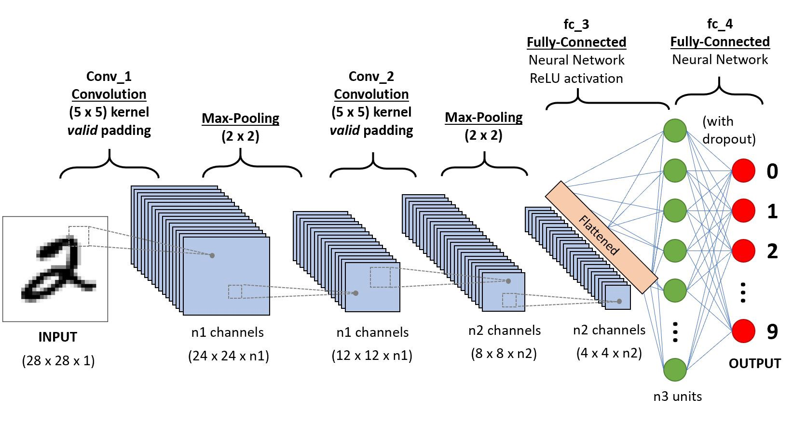
Example of CNN for Detection of Hand Written Digit

Slide 8
What exactly is a CNN?
In deep learning, a convolutional neural network (CNN/ConvNet) is a class of deep neural networks, most commonly applied to analyze visual imagery.
Now when we think of a neural network we think about matrix multiplications but that is not the case with ConvNet.
It uses a special technique called Convolution.
Now in mathematics convolution is a mathematical operation on two functions that produces a third function that expresses how the shape of one is modified by the other.
But we don’t really need to go behind the mathematics part to understand what a CNN is or how it works.
Bottom line is that the role of the ConvNet is to reduce the images into a form that is easier to process, without losing features that are critical for getting a good prediction.

Slide 9
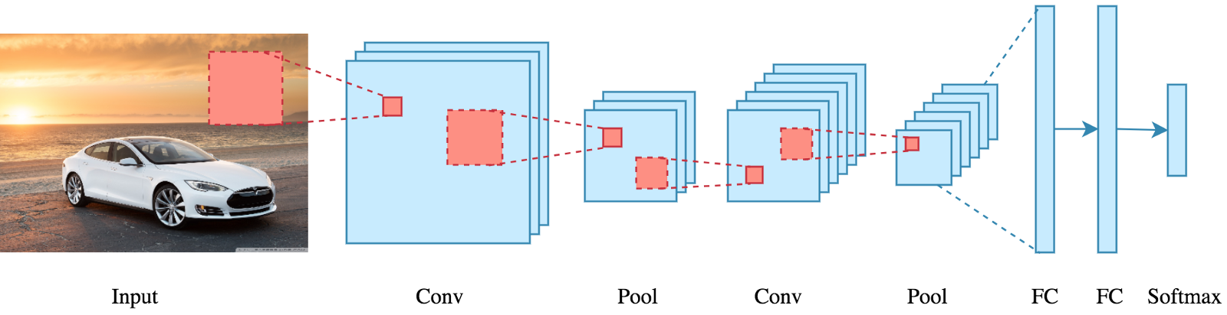

Slide 10
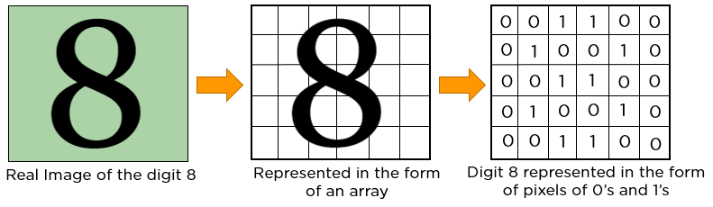
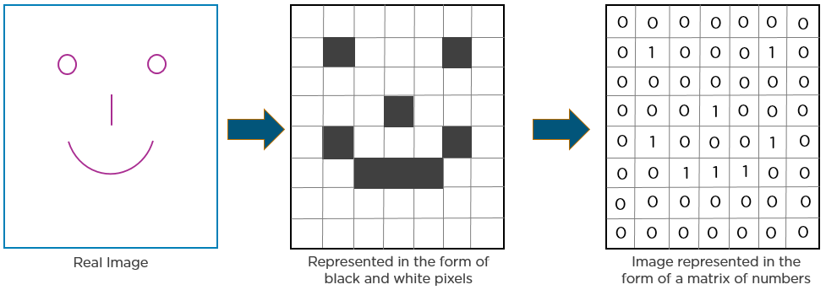
In CNN, every image is represented in the form of an array of pixel values.

